Slide 1
Final Presentation for Drug Persistency
Xiaoyan
07/30/2014

Slide 2
Introduction
The project is to analyze drug persistency data to identify patterns and factors that influence patient adherence to medication over time. Understanding these patterns will help the ABC drug company develop strategies to improve drug persistency, enhancing patient outcomes and business profitability.

Slide 3
Data Description
Total number of observations | 3424
Total number of files | 1
Total number of features | 69
Base format of the file | csv
Size of the data | 892 KB

Slide 4
Data Clean
Check duplicates
Check missing values
Rename column names

Slide 5
Data Preparation
Create frequency table of all variables
Check quantile(0.01) and quantile(0.99) for numerical variables
Build cross table between persistency_flag VS features

Slide 6
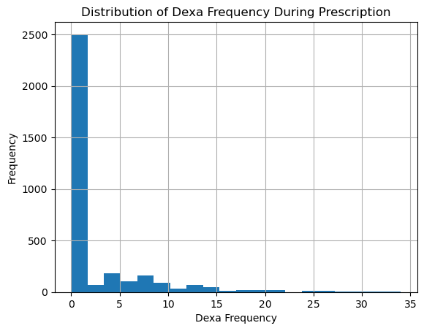
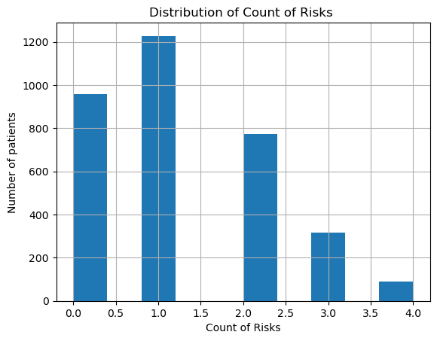
Data Visualization
The Distribution of dexa frequency during prescription is right skewed. There are 2488 patients never use dexa during the treatment and 114 of them use dexa for 1 time during the prescription.
The distribution of count of risks is right skewed. There are 1242 patients have 1 risk and 970 patients have no risks.

Slide 7
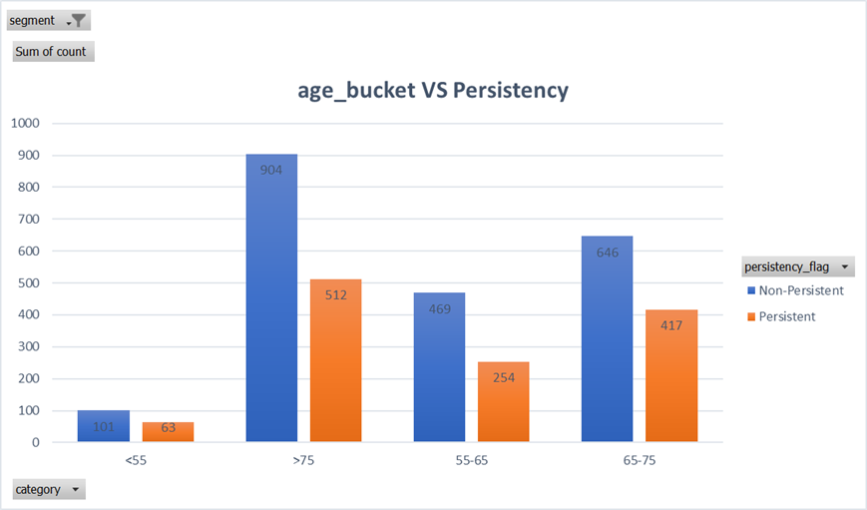
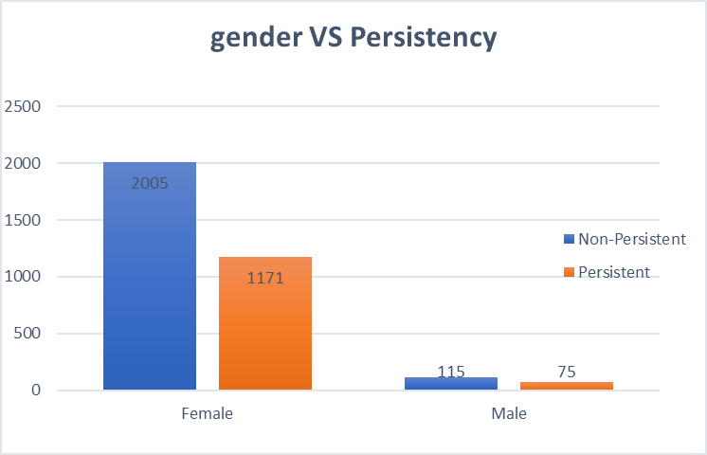
Visualization from patient Demographics
Patient are focus on 65-75 years old and older than 75 years. There are no significant difference in the proportion of Persistency and Non_persistency patient among different age group.
There are more than 3000 female patients and 190 male patients. There are no significant difference in the proportion of persistency and Non-persistency between the female and male group.

Slide 8
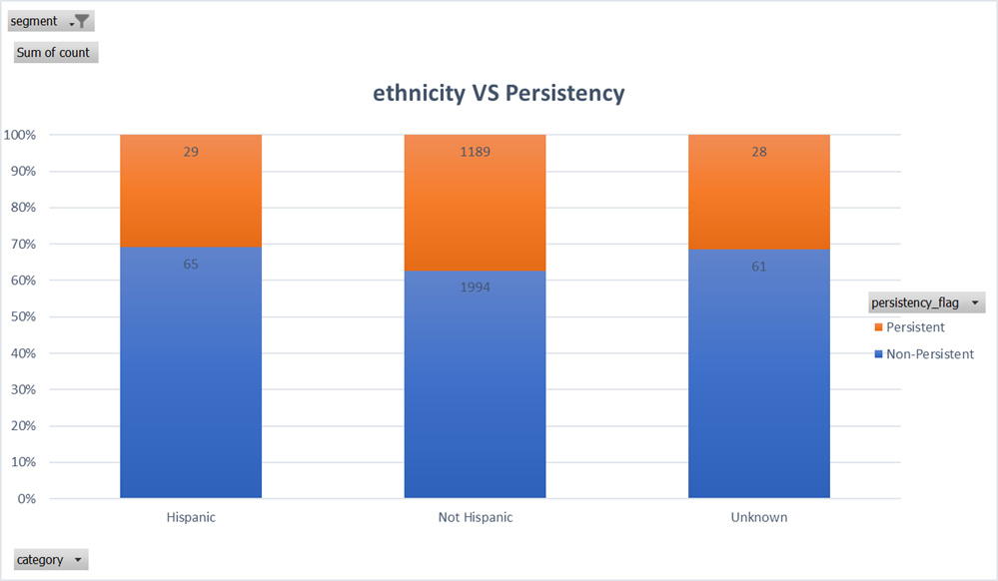
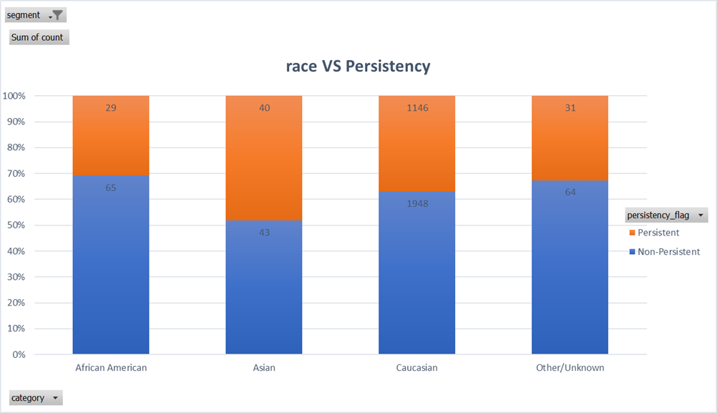
Visualization from patient Demographics
The patients are mainly from non Hispanic. There is no significant difference in the proportion of persistency and Non-persistency patients among different ethnicity group.
The patients are mainly from Caucasian. There is no significant difference in the proportion of persistency and Non-persistency patients among different race group.

Slide 9
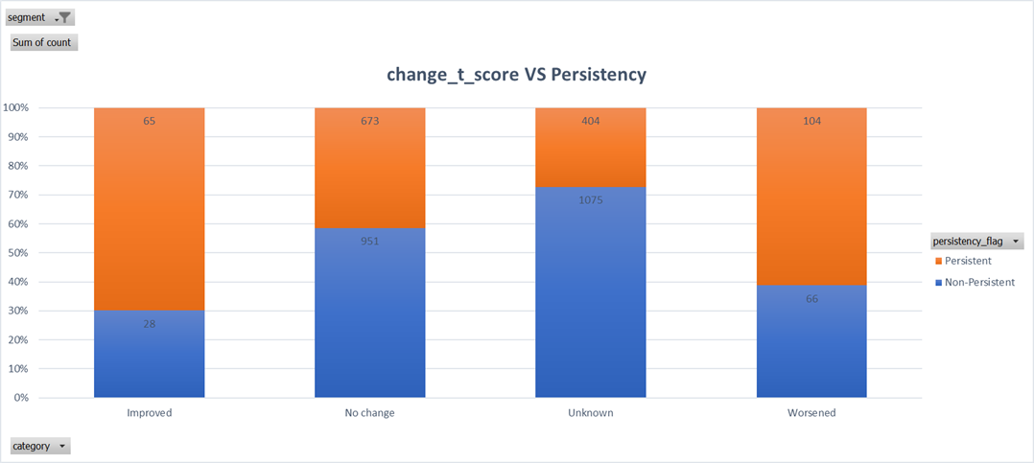
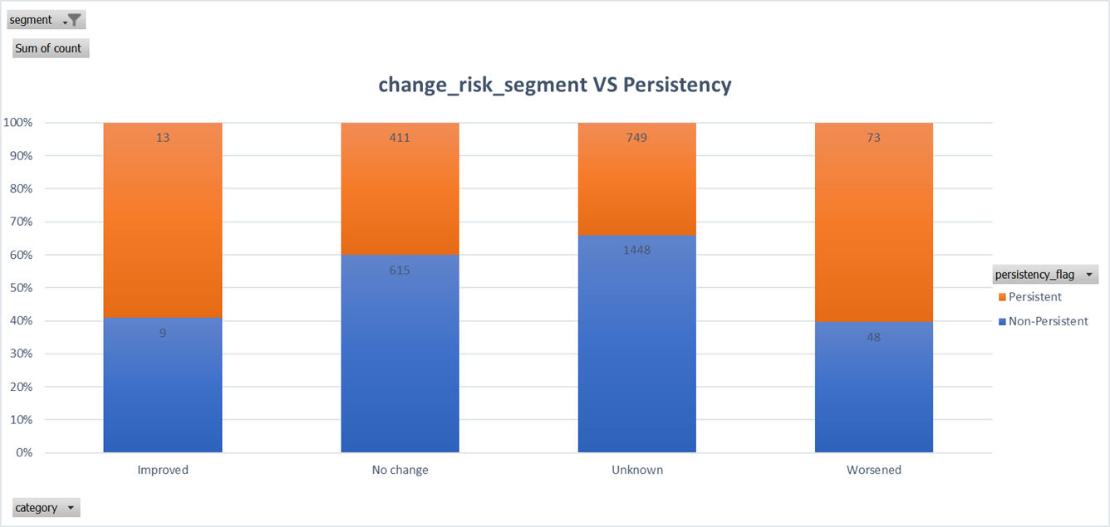
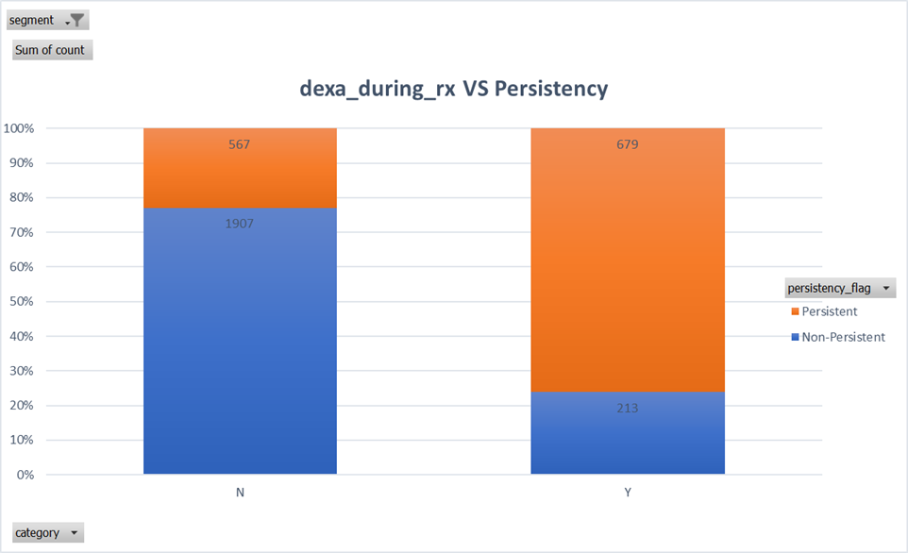
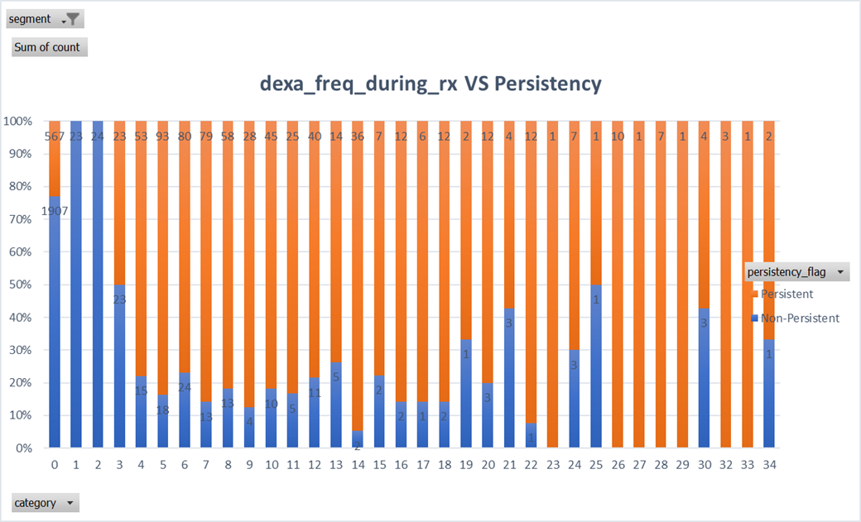
Visualization from Clinical Factors

Slide 10
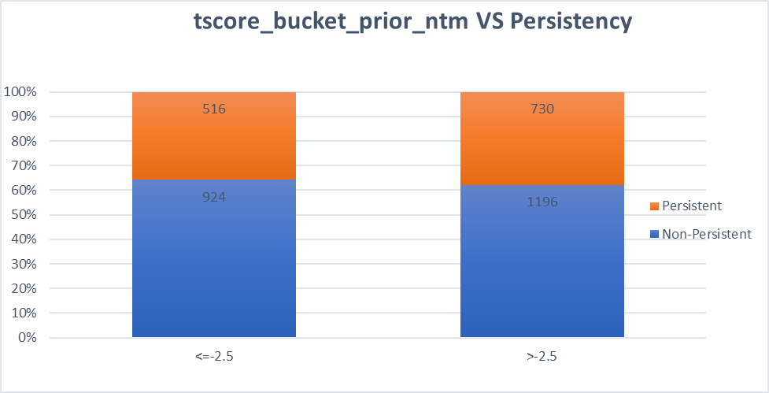
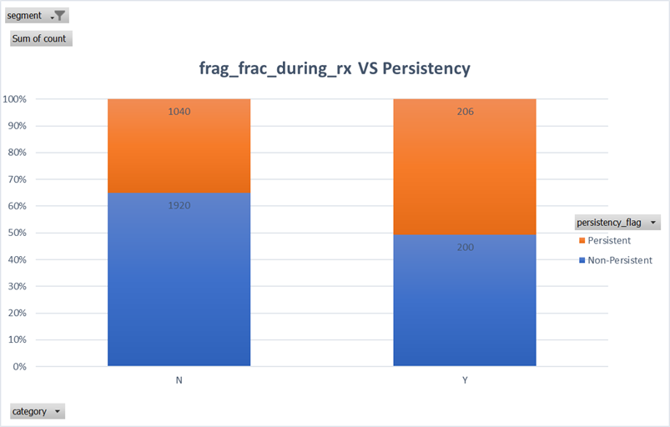
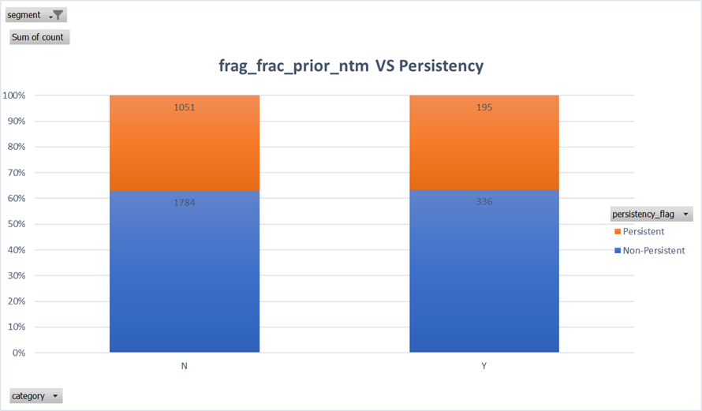
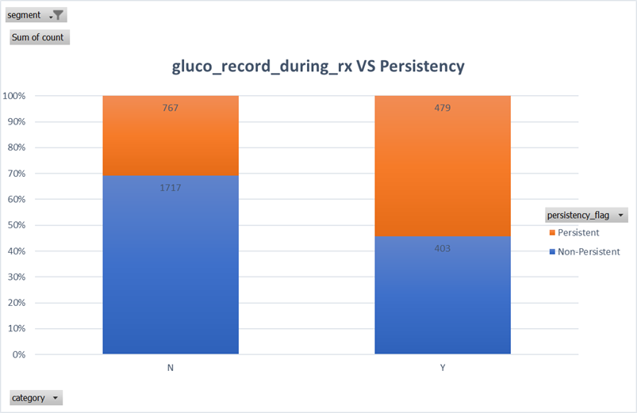
Visualization from Clinical Factors

Slide 11
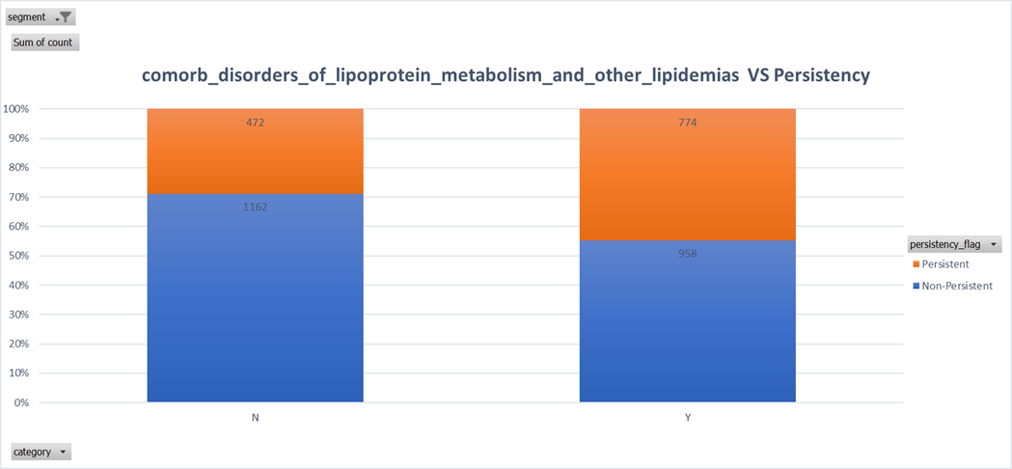

Visualization from NTM-Comorbidity
Among the patients with disorders_of_lipoprotein_metabolism_and_other_lipidemias, the proportion of persistency and Non-persistency is larger than the patients with no such symptom.
Among the patients with encntr_for_general_exam_w_o_complaint,susp_or_reprtd_dx, the proportion of persistency and Non-persistency is larger than the patients with no such symptom.

Slide 12
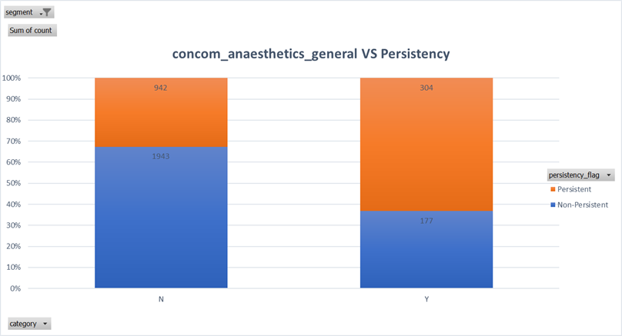
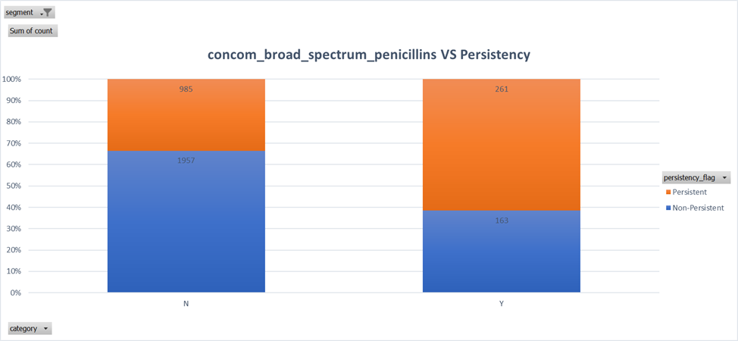
Visualization from NTM-Concomitancy
Among patients with NTM-Concomitancy, the ratio of persistency to Non-persistency is greater than that of patients with no NTM-Concomitancy.

Slide 13
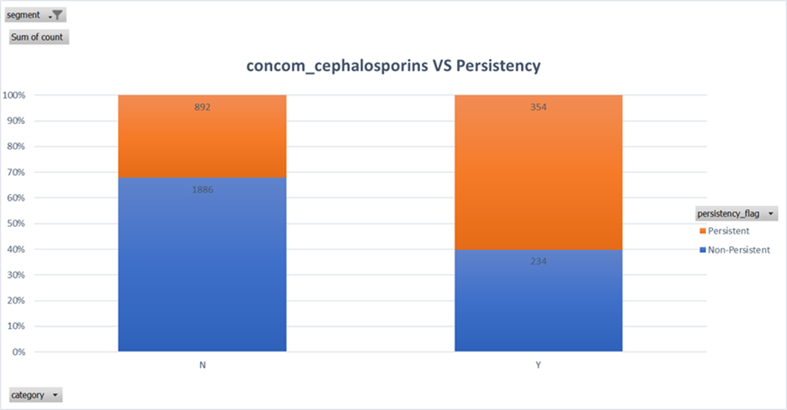

Visualization from NTM-Concomitancy
Among the patients with NTM-Concomitancy, the ratio of persistency to Non-persistency is greater than the patients with no NTM-Concomitancy.

Slide 14
Feature Engineering
Convert "Y" and "N" to 1 and 0
Create new Features: total number of concomitancy, total number of comorbidity
Encoding categorical variables: one-hot encoding
Scaling and normalization: log transformation
Feature Selection: drop columns which have no impact on drug_persistency

Slide 15
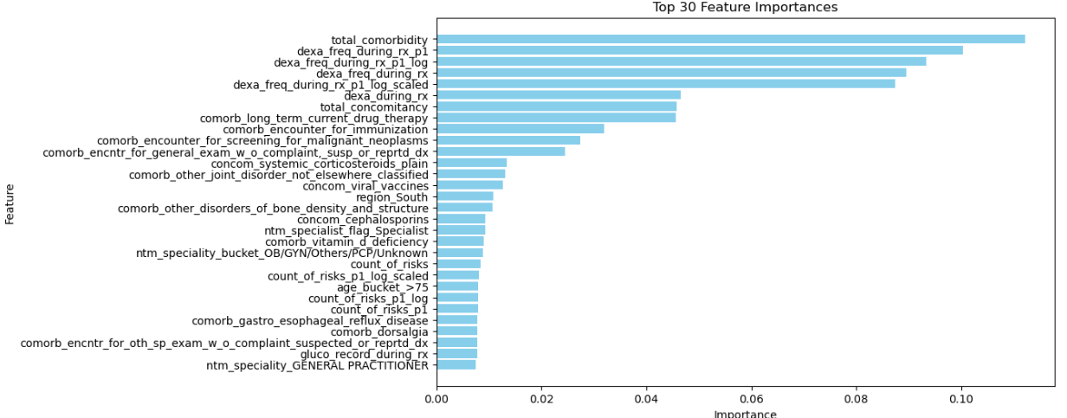
Test Variable Importance by Random Forest Model

Slide 16
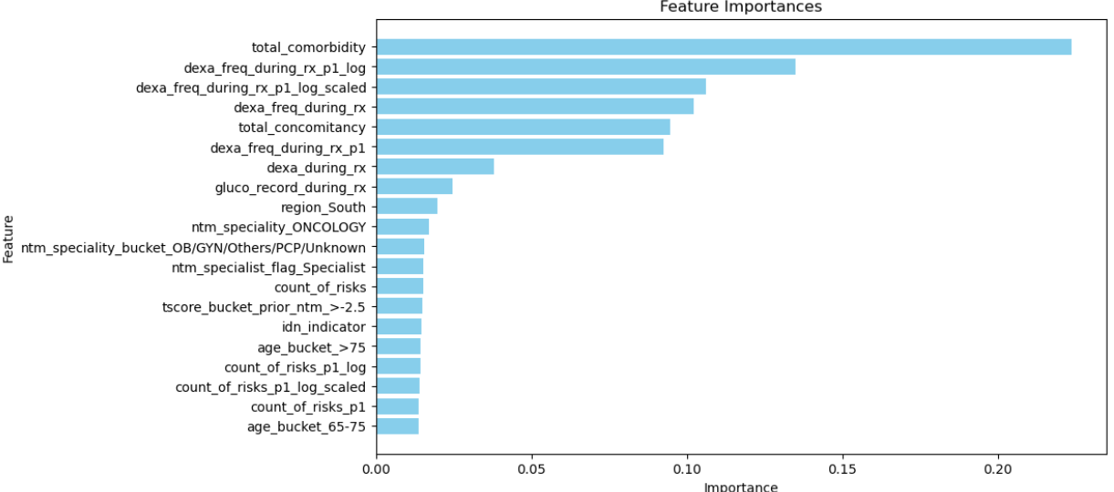
Top 20 Feature Importance

Slide 17
Recommendation for Tech Team
The following variables have no impact on drug persistency,
ptid , gender, frag_frac_prior_ntm, gluco_record_prior_ntm,
risk_patient_parent_fractured_their_hip, risk_segment_prior_ntm,
risk_untreated_chronic_hyperthyroidism, risk_estrogen_deficiency,
risk_family_history_of_osteoporosis
The top 5 features which can impact the drug persistency are,
total_comorbidity, dexa_freq_during_rx_p1_log,
dexa_freq_during_rx, total_concomitancy,
dexa_freq_during_rx_p1

Slide 18
Recommendation for Business Team
Create personalized intervention plans for patients with high comorbidity score.
Train healthcare providers to identify and manage patients with multiple comorbidities more effectively.
Develop systems to closely monitor the frequency of dexa prescriptions during treatment.
Establish better communication channels between patients and healthcare providers to discuss dexa usage and its impact on their health.
Implement comprehensive medication management programs to help patients manage their concomitant medications effectively.
Establish standardized protocols for prescribing dexa to ensure consistency across different healthcare providers and institutions.

Slide 19
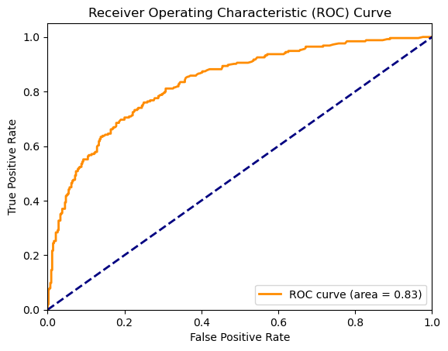
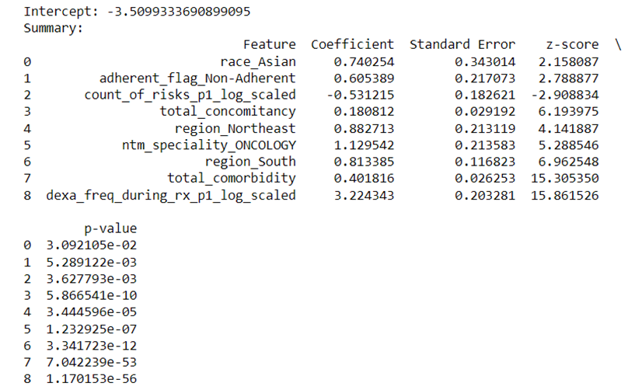
Results from Logistic Regression Model

Slide 20
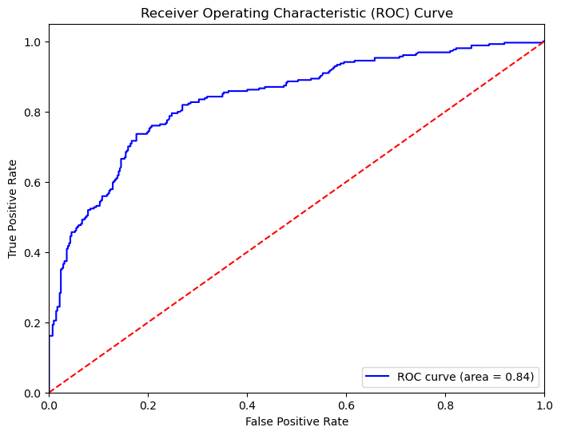
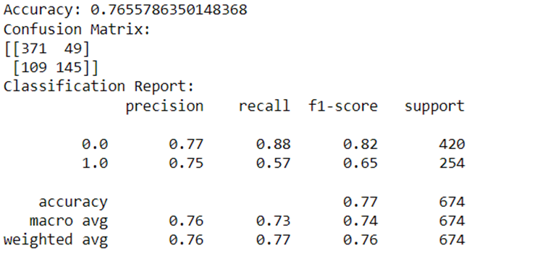
Results from Random forest Model

Slide 21
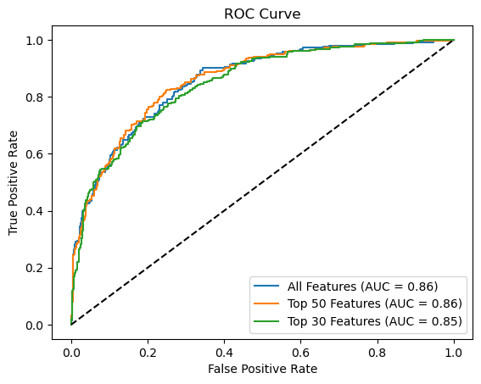
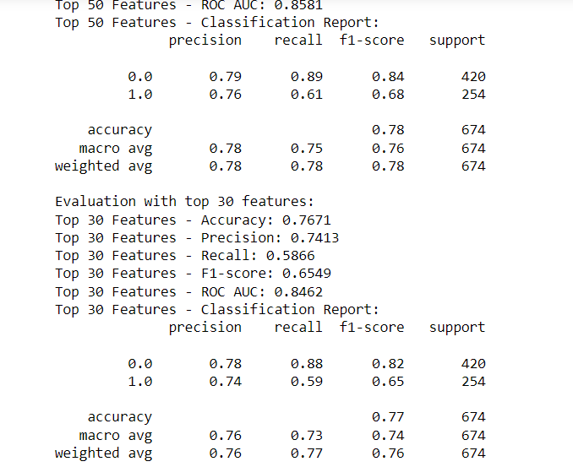
Results from XGB Model

Slide 22
Thank You

